Slide 1
Normal Distribution

Slide 2
Typical Data Science Cycle
Data Collection
Business Insights & Understanding
Data Understanding
Model Building & Evaluation
Data Pre-Processing

Slide 3
Probability Distribution
Probability refers to chance or likelihood of a particular event-taking place.
Probability of an event A is defined as the ratio of two numbers m and n.
P (A) =
where m= Set of all possible outcomes, denoted S. (say positive response on email campaign)
n= the total number of outcomes of the experiment (all possible outcomes) (# email sent in campaign)
Each event has a probability associated with it.

Slide 4
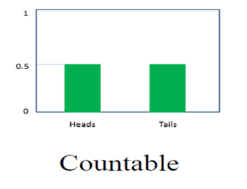
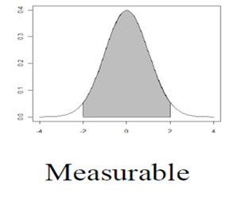
Probability Distribution
Probability Distribution
f(x) The mathematical function describing these possible values along with their associated probabilities
Two Types of Probability Distributions
Discrete
Continuous

Slide 5
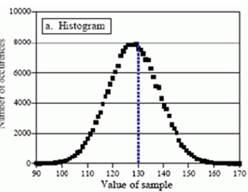
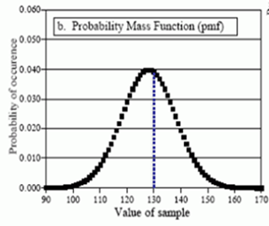
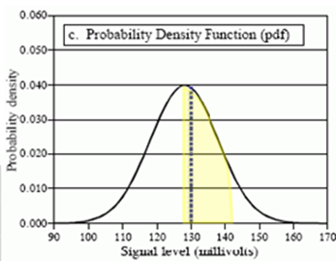
Probability Distribution
Histogram
PMF
PDF
( Discrete Probability Distribution)
( Continuous probability Distribution)

Slide 6
Probability Distribution
Example of Discrete probability distribution
Bernoulli Distribution
Binomial Distribution
Poisson Distribution

Slide 7
Probability Distribution
Example of continuous probability distribution
Normal Distribution
Student’s T probability Distribution
Chi square Distribution
F - Distribution

Slide 8
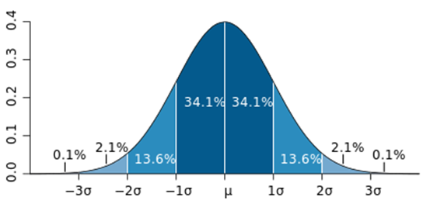

Normal (Gaussian) Distribution
Type of Continuous Probability Distribution
It is bell shaped curve
μ is the mean of distribution
σ is the standard deviation of distribution
𝑃𝑟𝑜𝑏𝑎𝑏𝑖𝑙𝑖𝑡𝑦 𝐷𝑒𝑛𝑠𝑖𝑡𝑦 𝐹𝑢𝑛𝑐𝑡𝑖𝑜𝑛
Shaded area gives the probability that X is between the corresponding values

Slide 9
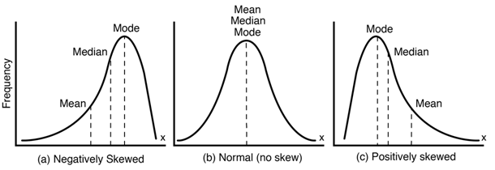
Normal (Gaussian) Distribution
Ideal Normal Distribution curve
Mean = Median = Mode = 0
Zero Skew

Slide 10
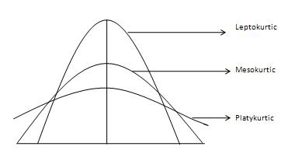
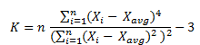
Normal (Gaussian) Distribution
Ideal Normal Distribution curve
•A standard normal distribution has
kurtosis of 3 and is recognized as
Mesokurtic
•some sources use kurtosis
(often referred to as "excess kurtosis") which is equal to kurtosis-3 to
make ideal kurtosis as zero

Slide 11
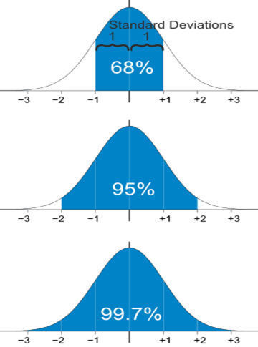
Normal (Gaussian) Distribution
Perfect Normal Distribution curve
68 – 95 – 99.7 empirical rule
(Derived by Chebyshev’s theorem )

Slide 12
Application
Application for perfect normal distribution concepts
A company produces a lightweight valve that is specified to weigh 1500g, but there are imperfections in the process. Products follow a normal distribution curve. While the mean weight is 1500g, the standard deviation is 300g.
Q1. What is the range of weights within which 95% of the valves will fall?
Q2. Approximately 16% of the weights will be more than what value?
Q3. Approximately 0.15% of the weights will be less than what value?

Slide 13
Application
Application for perfect normal distribution concepts
μ=1500 σ=300
Q1. What is the range of weights within which 95% of the valves will fall?
Q2. Approximately 16% of the weights will be more than what value?
Q3. Approximately 0.15% of the weights will be less than what value?
900 to 2100
More than 1800
Less than 600

Slide 14

Application
Standardization
When a frequency distribution is normally distributed but non- ideal i.e. μ is not 0 Or σ is not 1 , we can find out the probability of a score occurring by standardising the scores.

Slide 15
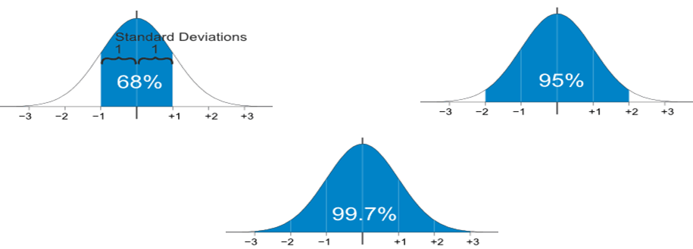
Application
Standardization
A company produces a lightweight valve that is specified to weigh 1500g, but there are imperfections in the process. Products follow a normal distribution curve. While the mean weight is 1500g, the standard deviation is 300g.

Slide 16
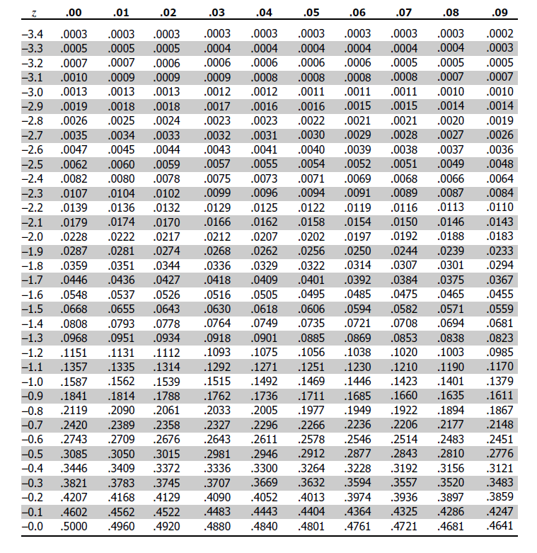
Application
Application for perfect normal distribution concepts
μ=1500 σ=300
Q3. Approximately 0.15% of the weights will be less than what value?
Values below z = -3 will have probability approximately 0.15%
-3=(x-1500)/300
Probability of weight < 600 will be 0.15%

Slide 17
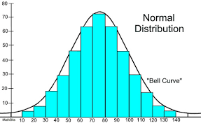
Test of normality
Approaches to test normality of a data set :
Visually inspection of graph (it should be a bell curve)
Skewness should be between -1 and 1
Kurtosis should be between -1 and 1
Mostly above techniques are used to test if a data is normal.
Still there are some advanced statistical test for normality which you can explore:
Shapiro - wilk test (p value < 0.05 signifies non-normal data)
K-S (Kolmogorov-Smirnov) test (p value < 0.05 signifies non-normal data)

Slide 18

Data Transformation
What if we require to transform data into normal distribution to fulfill assumptions of algorithms.
Logarithmic transformation : log(x) of the data (Derived from Box-Cox power transformation)
When λ = 0 for normalization

